Slide 1
DML – Joins and Subquery’s
So many tables, so little time

Slide 2
Agenda
SELECT
Recap
Limitations
Joins
All of ‘em
(INNER) JOIN
WHERE filter
Right/Left JOIN
Key’p an eye out
Subquery – SELECT in a SELECT
Why?
Example
Layers and layers

Slide 3
SELECT statement
Let’s recap.
What is the syntaxis of the select statement?
order
SELECT – Select columns that contain requested information/data → (output) [5] FROM – Select table that contains the necessary columns [1] WHERE – Create condition that data must meet [2] GROUP BY – Group data based on their value [3] HAVING – Create condition that data must meet, AFTER completion of SELECT [4] ORDER BY – Sort selected columns by value ASCending or DESCending [6]

Slide 4
Limitations
Just like humans can’t fly without assistance – a select statement also can’t do something without help.
But what?!
Showing (selecting) data from more than 1 table.
After all a select is built to retrieve data from 1 table and only 1 table.
The solution to all of this is to JOIN tables.

Slide 5
JOINS
A JOIN is a functionality that binds/mixes/joins two or more tables into a virtual composite table
The virtual table only exists for that moment the SELECT command uses it.
There are a lot of different kinds of joins available to database administrators.
Observe the following image.

Slide 6


Slide 7
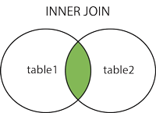
INNER JOIN
We will be placing our focus on the inner join. But all these joins have a certain place in SQL.
During the exam it might be usefull to know more then just the INNER JOIN, but it is not necessary.
The INNER JOIN binds two or more tables based comparing certain elements that are assigned inside the JOIN command.
This means that elements that do not match are not taken into the ‘virtual’ table.
An SQL example:
SELECT *
FROM CUSTOMER (INNER) JOIN ORDER
ON CUSTOMER.CUSTOMERID = ORDER.CUSTOMERID
Example:

Slide 8
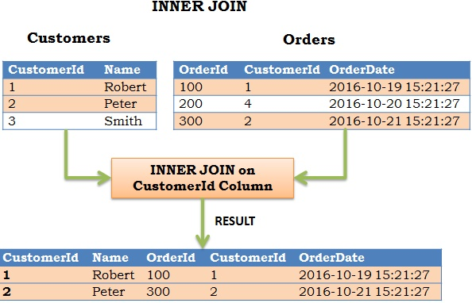

Slide 9
WHERE
What we can basically say is that a JOIN combines two or more tables and filters out all the not matching data.
We know another ‘filter’ inside the SQL language ➔ WHERE
This means we have a different way of writing the INNER JOIN namely like this:
SELECT *
FROM CUSTOMER, ORDER
WHERE CUSTOMER.CUSTOMERID = ORDER.CUSTOMERID
The above query will return the exact same result as using the (INNER) JOIN command.
Both are allowed on the exam.

Slide 10
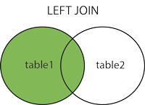
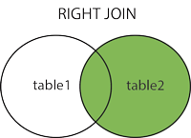
LEFT and RIGHT JOIN
Where INNER JOIN filters based on a condition that both tables must meet, RIGHT and LEFT JOIN do things differently.
RIGHT and LEFT JOIN take one of the two tables as BASE and will connect the rows of the other table where possible (based on the condition)
This means that rows from the basic table will always exist in the virtual table (output) and are supplemented with NULL where there is no 'connection’.
RIGHT JOIN takes the table that is newly added as a base LEFT JOIN takes the table that is first called as the base
SQL example:
SELECT *
FROM CUSTOMER
[LEFT/RIGHT] (OUTER) JOIN ORDER
ON CUSTOMER.CUSTOMERID = ORDER.CUSTOMERID
Result:

Slide 11
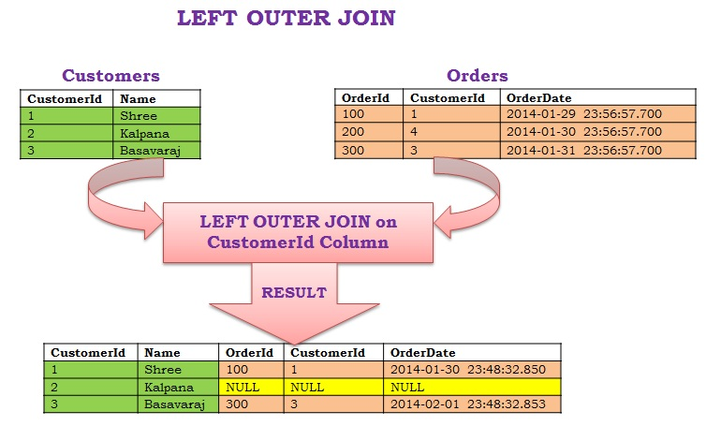

Slide 12
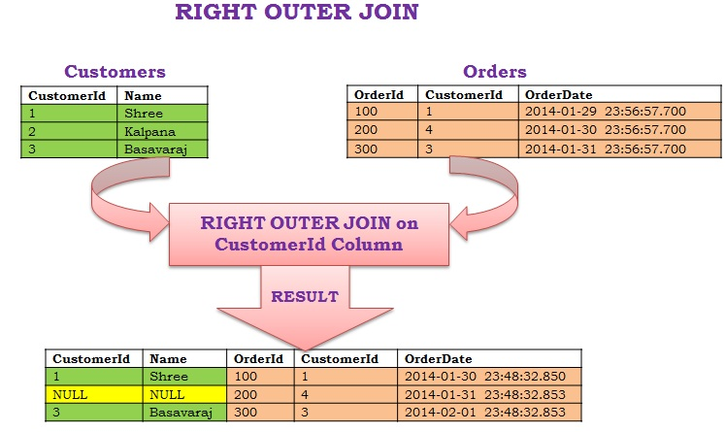

Slide 13
Key’p an eye out for
In 9 out of 10 cases the filter (or matching criteria) is the relation of Primary Key (PK) in one table with the Foreign Key (FK) in the other one.
Please make sure that you are JOINING or comparing data that you can actually compare.
Don’t join based on a comparison between date_of_birth and favourite_puppy
Or firstname and phone_number
However the exam can have questions that ask you to be creative.
Always think of the JOIN as a way to connect tables or to filter out certain data.
Remember that the = is just an operator. It can be replaced with <, > or any other operator.
Practice with this new functionality. It is the ONLY way to get the hang of this.

Slide 14
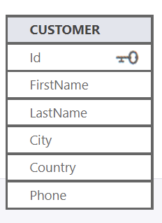
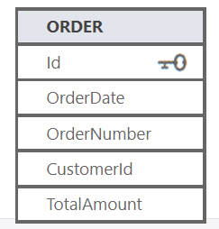
Subquery
A subquery is a SQL query nested inside a larger query.
A subquery may occur in :
- A SELECT clause
- A FROM clause
- A WHERE clause
A subquery is nothing more then a select inside another select
Anyone getting flashbacks to PHP1 nested loops?
It is often used because we still want to retrieve data from 1 single table, but with our exception (WHERE) originating from a different table
Yes this is possible, i’m not making this stuff up.
Let’s say i want to get a list of all the customers that have placed an order with a total amount higher than 100,00 euro.
SELECT firstname, lastname
FROM CUSTOMER
WHERE customerid IN (
SELECT customerid
FROM ORDER
WHERE TotalAmt > 100);

Slide 15
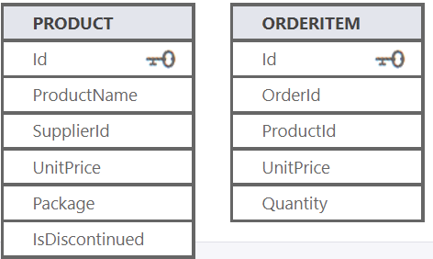
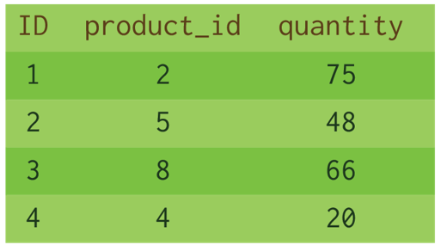
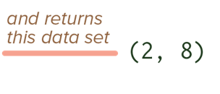
A different example
SELECT ProductName
FROM Product
WHERE Id IN ( SELECT ProductId
FROM OrderItem
WHERE Quantity > 50 )
Subquery that queries another table
So, the main query becomes:
SELECT ProductName
FROM Product
WHERE Id IN (2, 8)

Slide 16
Layers and layers
SELECT *
FROM Product, Order
WHERE Product.Product_ID = Order.Product_ID AND Order.Payment_Type_ID = (SELECT Payment_Type_ID
FROM Payment_Type
WHERE Description = ‘MASTERCARD’)
Just like JOINS, Subqueries can go multiple levels deep (or far).
If I need information on all the products that have been bought using the payment type “MASTERCARD”, how would that query look?

Slide 17
Subquery
A subquery is in fact nothing more than a SELECT query within a SELECT query.
Think of nested loops within PHP.
A subquery is often used to retrieve data based on a condition that can be found within another table.
Let's say I want an overview of all my customers who have placed an order over 100 euros.
SELECT firstname, lastname
FROM customer
WHERE customerid IN (
SELECT customerid
FROM order
WHERE TotalAmt > 100);

Slide 18
Questions?

